Slide 1

Helix Group – Final Security Project Presentation
Zero Trust SSO Integration for Oringo Ltd
June 2025

Slide 2
PROJECT OVERVIEW
THE CHALLENGE
OUR SOLUTION
SECURITY STRATEGY
Oringo Ltd. needed secure access to AWS
Integrated Microsoft Entra ID with AWS
Enforced Multi-Factor Authentication (MFA)
They wanted to avoid creating AWS accounts for each user
Used SAML-based SSO for identity federation
Group-based Role-Based Access Control (RBAC)
Conditional Access policies (e.g., location, device)

Slide 3
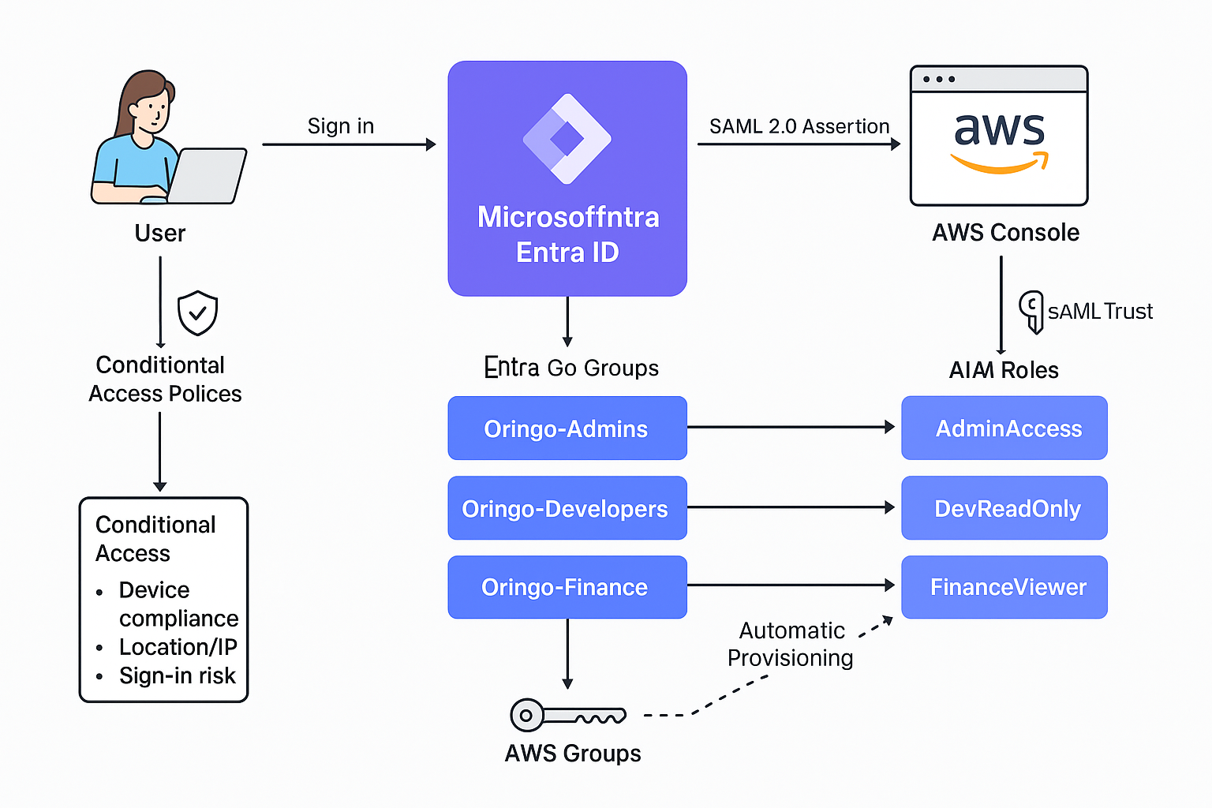
ARCHITECTURE DIAGRAM
This diagram illustrates how users from roboboy.online are authenticated via Microsoft Entra ID with enforced MFA and Conditional Access policies. Group membership determines the IAM role assigned in AWS through a SAML token, granting secure access to the AWS Console based on job role.

Slide 4
GROUP ROLE
AND MAPPING
USER | ENTRA GROUP | IAM ROLE | ACCESS LEVEL
idris.musa@roboboy.online | GRP-AWS-AdminAccess | AdminAccess | Full AWS admin rights
david@roboboy.online | GRP-AWS-DevReadOnly | DevReadOnly | Read-only access to dev tools
fola@roboboy.online | GRP-AWS-FinanceViewer | FinanceViewer | View-only access to billing features
Each user is assigned to a Microsoft Entra group representing their department. These groups are mapped to specific AWS IAM roles, granting access based on job responsibilities.

Slide 5
ZERO TRUST CONTROLS
Enforced Multi-Factor Authentication using Microsoft Authenticator for all users
FEDERATED IDENTITY
AWS trusts Entra ID via SAML, so no AWS passwords are stored
MFA
CONDITIONAL ACCESS
Access rules based on location, device compliance, and sign-in risk
CENTRAL ROLE MANAGEMENT
All access is managed centrally from Entra, not directly in AWS
GROUP-BASED ACCESS
Roles are assigned based on Entra group membership — not individual users
LEAST PRIVILEGE ENFORCEMENT
Each user receives only the access required for their role

Slide 6
FUNCTIONAL DEMO SUMMARY
CREATED 3 USER GROUPS IN MICROSOFT ENTRA ID USING NAMING CONVENTIONS
PLACED USERS INTO DEPARTMENT-BASED ENTRA GROUPS
CONFIGURED AWS IAM ROLES AND TRUST RELATIONSHIPS
LINKED ENTRA ID WITH AWS VIA SAML-BASED SSO
ATTEMPTED LOGIN — SAML TOKEN GENERATED, BUT ACCESS FAILED
IDENTIFIED THE NEED TO CONFIGURE THE RIGHT PERMISSION BEFORE LOG-IN
SETUP CONDITIONAL ACCESS POLICIES
DOCUMENTED TROUBLESHOOTING STEPS AND LESSONS LEARNED

Slide 7
USER
PROVISIONING
SCIM PROVISIONING WAS ENABLED TO AUTOMATICALLY SYNC USERS AND GROUPS FROM MICROSOFT ENTRA ID TO AWS.
ENTRA USED TO SIMULATE GROUPS ROLE-BASED ACCESS
USERS CREATED MANUALLY VIA MICROSOFT 365 ADMIN CENTER
LOCATION FIELD ADDED TO ENFORCE CONDITIONAL ACCESS

Slide 8
COMPLIANCE
MAPPING
STANDARD | HOW WE MET IT
DORA | Used SSO with Microsoft Entra ID; no credentials stored in AWS
ISO 27001 | Applied MFA, Conditional Access, and role-based access control
NIST 800-53 | Role mappings aligned with identity-based access controls (IA family)
These standards help validate our architecture as secure, identity-driven, and compliant with Zero Trust principles.

Slide 9
TEAM REFLECTION
WE DEEPENED OUR UNDERSTANDING OF HOW SAML WORKS BETWEEN IDENTITY PROVIDERS AND AWS
WE PRACTICED REAL RBAC IMPLEMENTATION USING ENTRA GROUPS AND IAM ROLES
WE LEARNED TO TROUBLESHOOT TRUST RELATIONSHIP ERRORS AND METADATA ISSUES
EACH MEMBER CONTRIBUTED MEANINGFULLY — FROM SETUP TO DOCUMENTATION
COLLABORATING ON ACCESS CONTROL REINFORCED OUR APPRECIATION FOR ZERO TRUST ARCHITECTURE
WE GOT BETTER AT NAVIGATING REAL ADMIN PORTALS AND CONFIGURATIONS (NOT JUST THEORY)

Slide 10









MEET THE TEAM – Helix Group
TITILAYO YUSUF -
(TEAM LEAD)
ADEMOLA IYANDA
FOLUSHO OWOEYE
FRANCA IBUZO
MOSES ANAWO
NABILAH KAFI
NGUSHA ORTI

Slide 11
THANK YOU!
We’re happy to take any questions.

